Slide 1
3.9 Descartes Rule
Exercise sums of Ex 3.6

Slide 2
Q1) Discuss the maximum Possible number of positive and Negative roots of the Polynomial equation
9
8
7
6
5
3
2
9x - 4x + 4x - 3x + 2x +x + 7x + 7x + 2 = 0
Solution :-
9
8
7
6
5
3
2
Let P(x) = 9x - 4x + 4x - 3x + 2x +x + 7x + 7x + 2
Signs : + , - , + , - , + , + , + , + , +
No.of Sign Changes = 4
Therefore, Positive Roots < 4
_

Slide 3
9
8
7
6
5
3
2
Let P(- x) = - 9x - 4x - 4x - 3x - 2x - x + 7x - 7x + 2
Signs : - , - , - , - , - , - , + , - , +
No.of Sign Changes = 3
Therefore, Negative Roots < 3
_
Positive roots < 4 , Negative roots < 3
_
_

Slide 4
Q2) Discuss the maximum Possible number of positive and Negative roots of the Polynomial equation
2
2
x - 5x + 6 and x - 5x + 16
.Also Draw rough Sketch of the graphs
2
i) x - 5x + 6
2
Solution :-
P(x) = x - 5x + 6
Signs : + , - , +
No.of Sign Changes = 2
Therefore, Positive Roots = 2 or 0

Slide 5
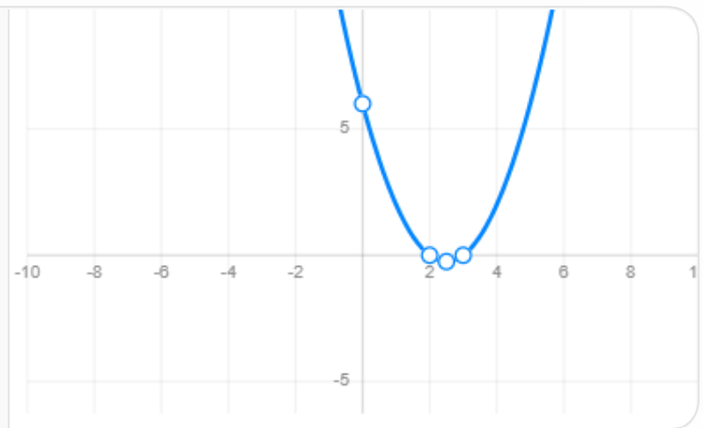
2
P(-x) = x + 5x + 6
Rough Graph
Signs : + , + , +
No.of Sign Changes = 0
Therefore, Negative Roots = 0
2
Factorising : x - 5x + 6 = (x - 2)(x - 3)
Answer : Positive roots =2
Negative roots =0
Roots are 2,3

Slide 6
Q2) Discuss the maximum Possible number of positive and Negative roots of the Polynomial equation
2
2
x - 5x + 6 and x - 5x + 16
.Also Draw rough Sketch of the graphs
2
ii) x - 5x + 16
2
Solution :-
P(x) = x - 5x + 16
Signs : + , - , +
No.of Sign Changes = 2
Therefore, Positive Roots = 2 or 0

Slide 7
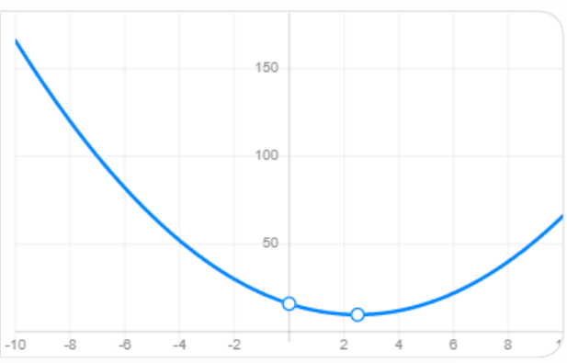
2
P(-x) = x + 5x + 16
Rough Graph
Signs : + , + , +
No.of Sign Changes = 0
Therefore, Negative Roots = 0
2
Discriminant : D = b - 4ac
(The graph does not cut the x-axis)
2
= (-5) - 4(1)(16)
=25 - 64
= -39 < 0
Answer : Positive roots =2, Negative roots =0
No real roots

Slide 8
9
5
4
2
Q3 ) Show that x - 5x + 4x + 2x + 1 = 0 has atleast Six imaginary Solutions.
Solution :-
9
5
4
2
P(x) = x - 5x + 4x + 2x +1
Signs : + , - , + , + , +
No.of Sign Changes = 2
Therefore, Positive Roots < 2
_

Slide 9
9
5
4
2
P(- x) = -x + 5x + 4x + 2x +1
Signs : - , + , + , + , +
No.of Sign Changes = 1
Therefore, Negative Roots < 1
_
Real roots = 2 + 1
= 3
Imaginary roots = 9 - 3
= 6
At least 6 imaginary roots
Hence shown

Slide 10
Q4) Determine the number of positive and negative roots of the equation
9
8
7
x - 5x – 14x = 0
Solution :-
9
8
7
P(x) = x - 5x - 14x
Signs : + , - , -
No.of Sign Changes = 1
Therefore, Positive Roots < 1
_

Slide 11
9
8
7
P(- x) = - x - 5x + 14x
Signs : - , - , +
No.of Sign Changes = 1
Therefore, Negative Roots < 1
_
Therefore, Positive roots = 1 Negative roots =1

Slide 12
Q5) Find the exact number of real zeros and imaginary zeros of
9
7
5
3
x + 9x + 7x + 5x + 3x = 0
Solution :-
9
7
5
3
P(x) = x + 9x + 7x + 5x + 3x
Signs : + , + , + , + , +
No.of Sign Changes = 0
Therefore, Positive Roots =0

Slide 13
9
7
5
3
P( - x) = - x - 9x - 7x - 5x - 3x
Signs : - , - , - , - , -
No.of Sign Changes = 0
Therefore, Negative Roots =0
8
6
4
2
x( x + 9x + 7x + 5x +3) = 0
thus , x = 0 is a real root
Degree = 9
Imaginary roots = 9-1
= 8
Real root = 1 & Imaginary roots = 8

